Slide 1
Demand Prediction: EDA
11.08.2017
Nirmal Budhathoki
Garrett Cheung
Jillian Jarrett
Toby Moreno
Orysya Stus
Notes:
For this milestone, our team is continuing our to explore the data and facilitate EDA for other groups.

Slide 2
Team Update
Third Milestone
Migrating Linode Server functionality to Local Hosts and UCSD Servers
Expanding Python APIs for Team Demand
Methods tailored to Team Demand defined queries
Initiating TF/IDF and sentiment analysis in Solr

Slide 3
Team Demand Queries
What are the top 3 categories of books that are most read around Christmas?
What time of the year are the sales of “Education” books the highest?
Given month m and category c, predict the amount of sales for the category.
Which book categories show a downward trend in demand in Winter and Spring?
Is there a category that we should discontinue stocking?
Notes:
Team Demand opted to deep dive in this subset of the queries. Approaches and underlying assumptions made while tackling these problems were agreed upon by all teams.

Slide 4
Current API Functionality
/api/service (accepts dynamic params)
/api/covariance
/api/correlation
/api/histogram/groupby/count
/api/Top_Categories
/api/Highest_Sales_byCategory
/api/sensititvity_polarity/size
/api/Downward_Trend
/api/Discontinue_Stocking
Access server.py code here: https://github.com/mas-dse-jejarret/DSE203_Demand_EDA/blob/master/www/server.py
Note: Testing API functionality completed via UCSD Server connection.
Notes:
The left column shows functions built for Milestone 2, while the right column depicts new functions created specifically to address the queries of interest

Slide 5
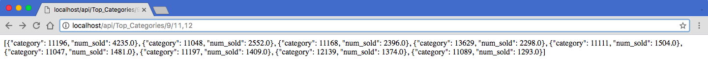
Query 1: /api/Top_Categories
Sample Query: What are the top 3 categories of books that are most read around Christmas?
Generalized Query: What are the top categories of books read in a particular month(s)? (Scalable)
Input parameters: number of categories, month
Returns: dictionaries of category ids, units sold
Sample Output:
Future Ambition: Applying string matching techniques to category parameters to compensate for typos, generalizing query further to consider top sales, amount, etc. in regards to demand.

Slide 6
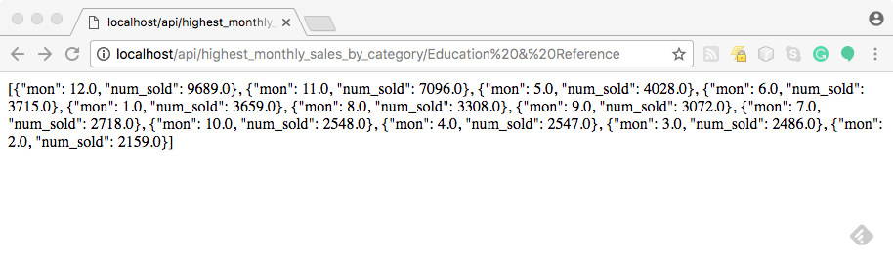
Query 2: /api/Highest_Sales_by_Category
Sample Query: What time of the year are the sales of “Education” books the highest?
Generalized Query: What time of the year are the sales of X category/ies of book the highest? (Scalable)
Input parameter: category Returns: dictionaries of month and num sold
Future Ambition: Applying string matching techniques to category parameters to compensate for typos

Slide 7
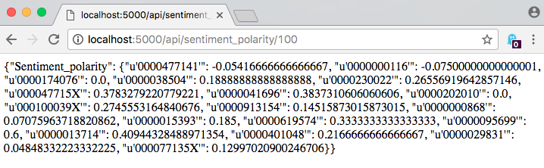
Query 3: /api/sentiment_polarity
Sentiment Analysis API method:
EDA team has completed generating Sentiment Polarity score for all the reviews extracted from Solr datasource.
Next: ML team will use this data as one of the features to test if it will be helpful for their model to make prediction (Query 3).
Notes:
API is completed to generate sentiment polarity score between [-1,1] where negative bound values shows negative sentiment, and positive bound value shows positive sentiment, values around 0 is neutral sentiment. The score is averaged for each product by asin code. The total reviews to grab from solr can be passed as parameter to API ( 100 in this example), since 100 is total reviews, the average review score per unique product will be lower value as output.

Slide 8
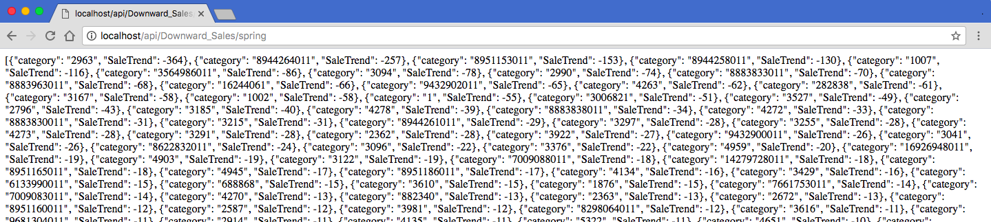
Query 4: /api/Downward_Trend
Sample Query: Which book categories show a downward trend in demand in Winter and Spring?
Generalized Query: Which book categories show a downward trend in demand in a particular month? (scalable)
Input parameters: season (‘spring’, ‘summer’, ‘fall’, ‘winter’)
Returns: dictionaries of category ids and sale trends
Future Ambition: Allow multiple seasons to be considered or consider specific months rather than seasons.

Slide 9
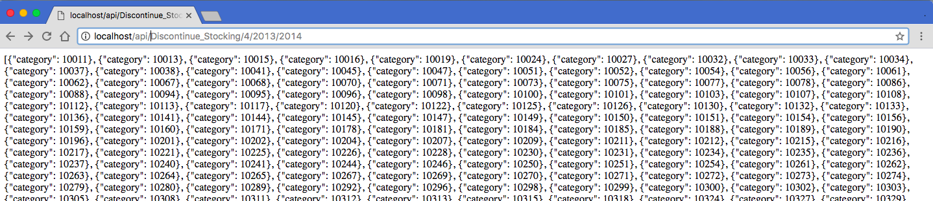
Query 5: /api/Discontinue_Stocking
Sample Query: Is there a category that we should discontinue stocking?
Generalized Query: Is there a category which performs poorly in a date range? (scalable)
Input parameters: threshold, start year, end year
Returns: dictionaries of categories where books sold < threshold
Future Ambition: Expand date ranges from year to specific dates or according to expectations of ML team. This is a useful query for filtering.

Slide 10
Query Optimization
Team EDA has yet to implement infrastructure for optimizing our API methods
We plan to investigate the following:
Request (server side) caching
Client side caching
Indexing
Sampling
We will also investigate which functions are most likely to be used frequently and which have the highest execution times

Slide 11
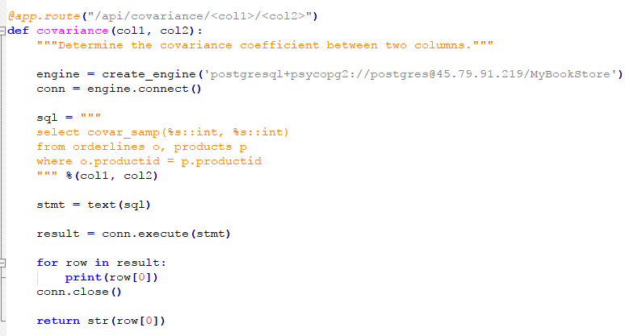
API Development Process with Machine Learning and Query Capability/Other Teams and Demo
Machine learning
Define function, inputs, and outputs
Query capability and learning
Optimize data source connections
Integrated schema and justification
Materialize views prior to API calls
Sample function code from EDA API.
Notes:
Projections as to how EDA will interactions with other teams

